Slide 1

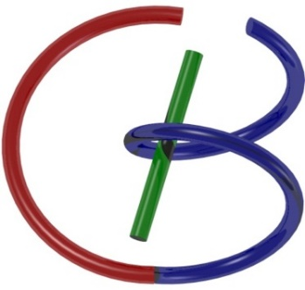
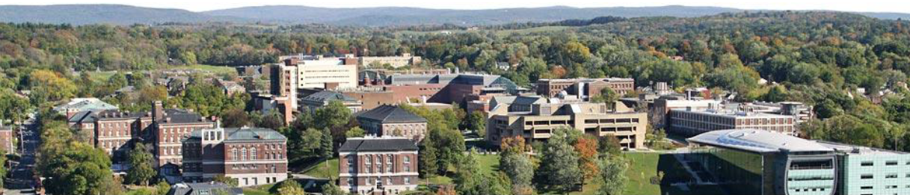
MRI Physics
Ge Wang
AI-based X-ray Imaging System (AXIS) Lab
Rensselaer Polytechnic Institute, Troy, New York, USA
Oct. 12, 2021

Slide 2
Homework
Finishing reading Chapter 3 of the textbook by Paul
Understand the derivation steps (Eqs. (1) – (10)) in the 1st cone-beam spiral/helical CT paper (approximate spiral cone-beam reconstruction): https://ieeexplore.ieee.org/stamp/stamp.jsp?tp=&arnumber=241876, and explain the derivation in your own words in a tutorial-like report (see the following slides as hints)

Slide 3


Slide 4
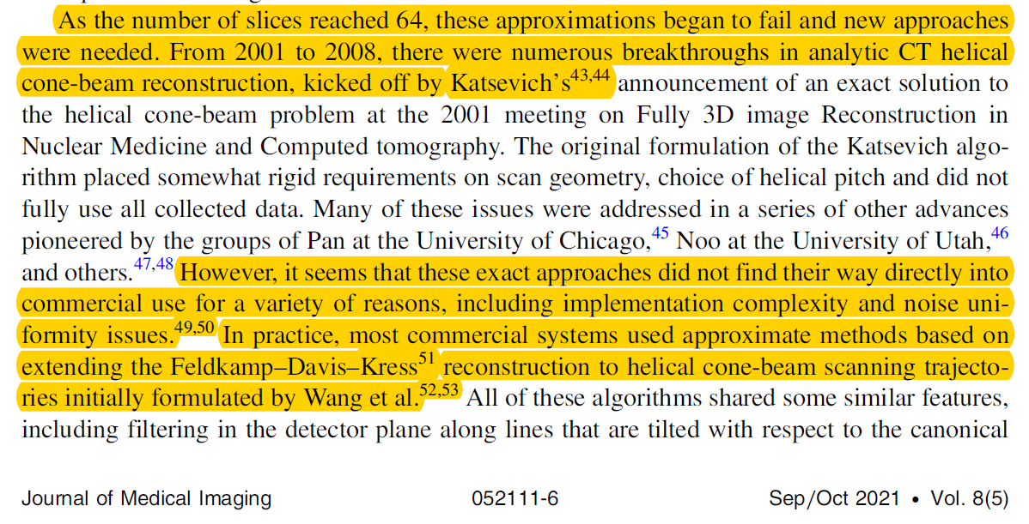

Slide 5
MI Schedule for F21
Tue | Topic | Fri | Topic
08/31 | Introduction | 09/03 | Neuron, Network & Backpropagation
09/07 | No Class | 09/10 | Hands-on 1: Python, Colab, & TensorF
09/14 | Architectures & Training | 09/19 | Hands-on 2: MNIST Classification
09/21 | Image Quality I | 09/24 | CT Physics
09/28 | CT Reconstruction | 10/01 | Deep CT Reconstruction
10/05 | Hands-on 3: CT Networks | 10/08 | More CT Contents
10/12 | MRI Physics | 10/15 | Spin-Echo
10/19 | K-Space Theorem | 10/22 | More MRI Contents
10/26 | Mid Exam | 10/29 | Deep MRI Reconstruction
11/02 | Hands-on 4: MRI Networks | 11/05 | Nuclear Physics
11/09 | Nuclear Imaging | 11/12 | US Imaging
11/16 | Optical Imaging | 11/19 | Multimodality Imaging
11/23 | Hands-on 5: Image Conversion | 11/26 | Thanksgiving
11/30 | Image Quality II | 12/03 | Stability, Interpretability, & Others
12/07 | Overview | 12/10 | Final Exam
Office Hour: Teaching Day 5-6pm: https://rensselaer.webex.com/meet/wangg6

Slide 6
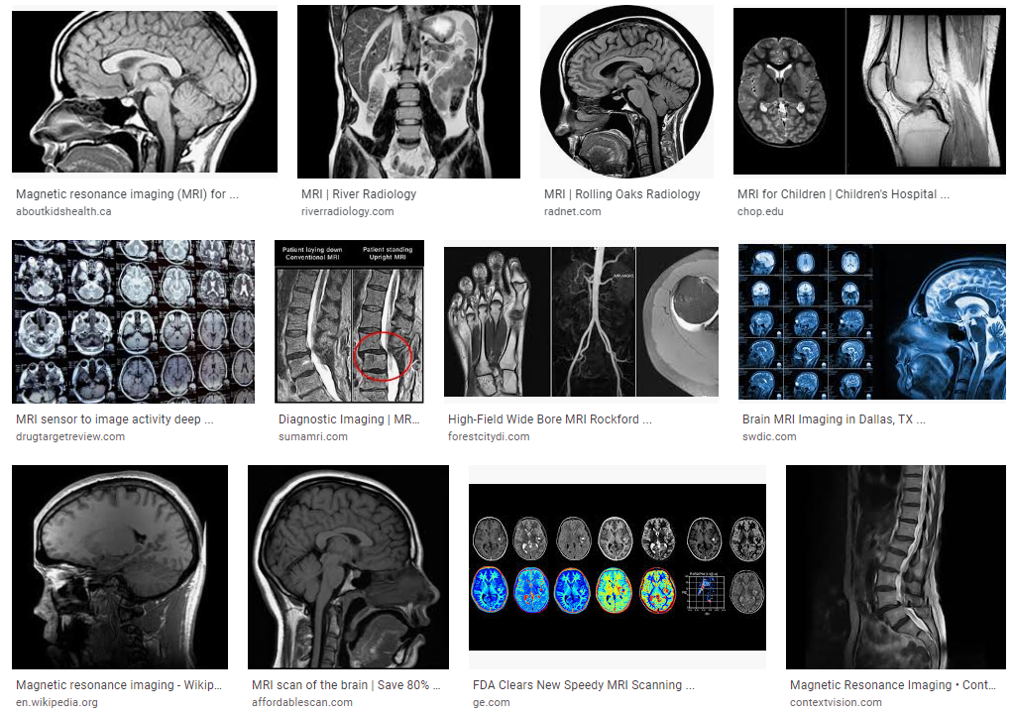
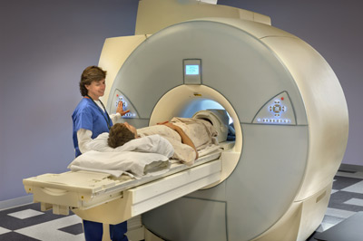
Magnetic Resonance Imaging (MRI)

Slide 7
Outline
Physics
High School Electromagnetism
Maxwell’s Equations
Mechanics
Force to Torque
Precession

Slide 8
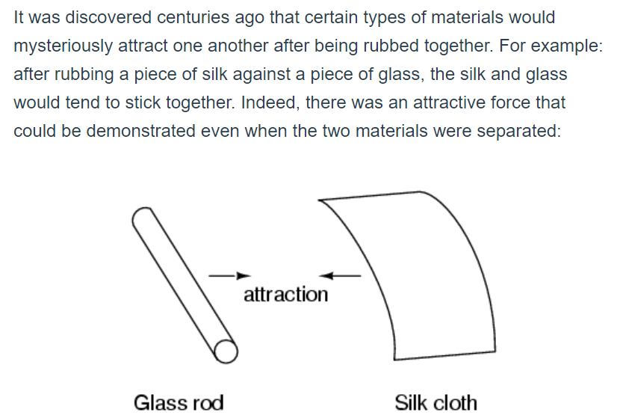
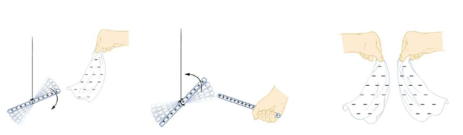
Electric Charges

Slide 9
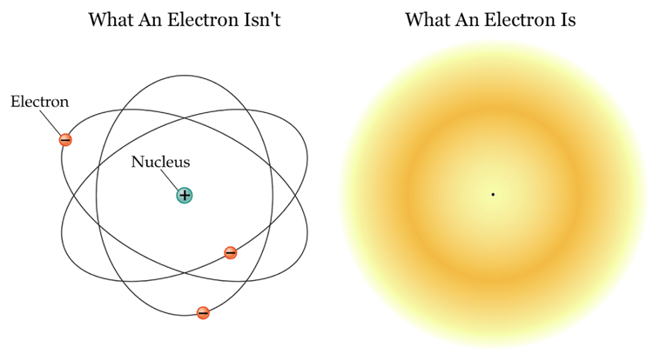
Appearance of an Electron

Slide 10
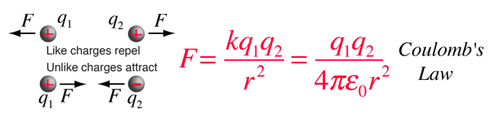
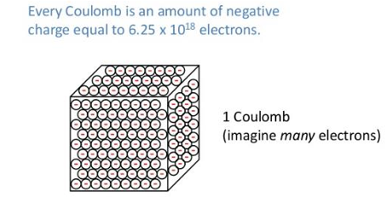
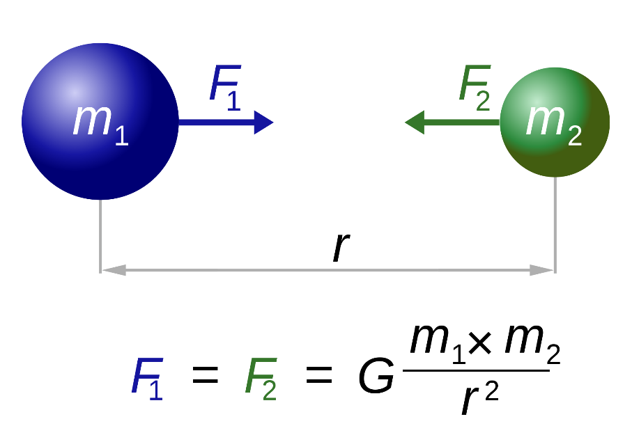
Electrical Force

Slide 11
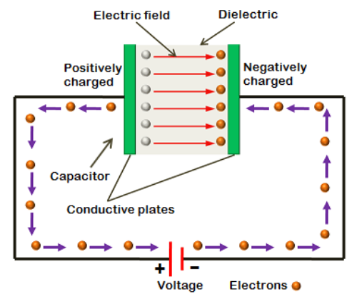
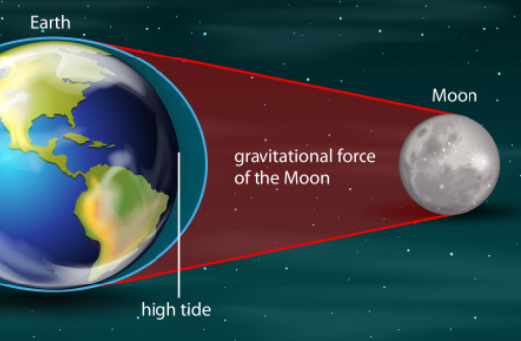
Electrical Field

Slide 12
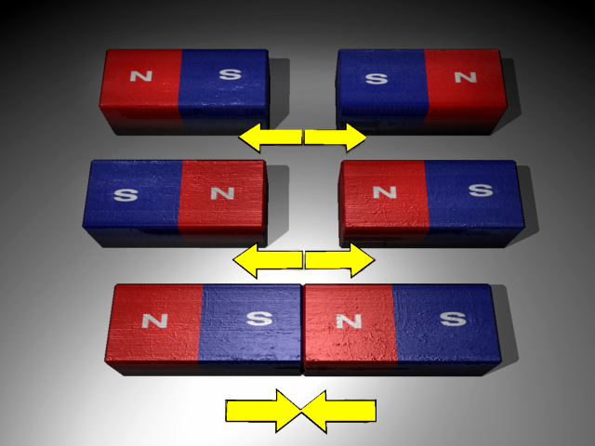
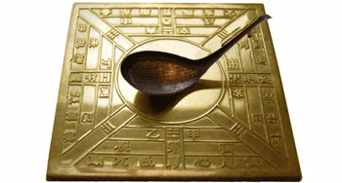
Magnet

Slide 13
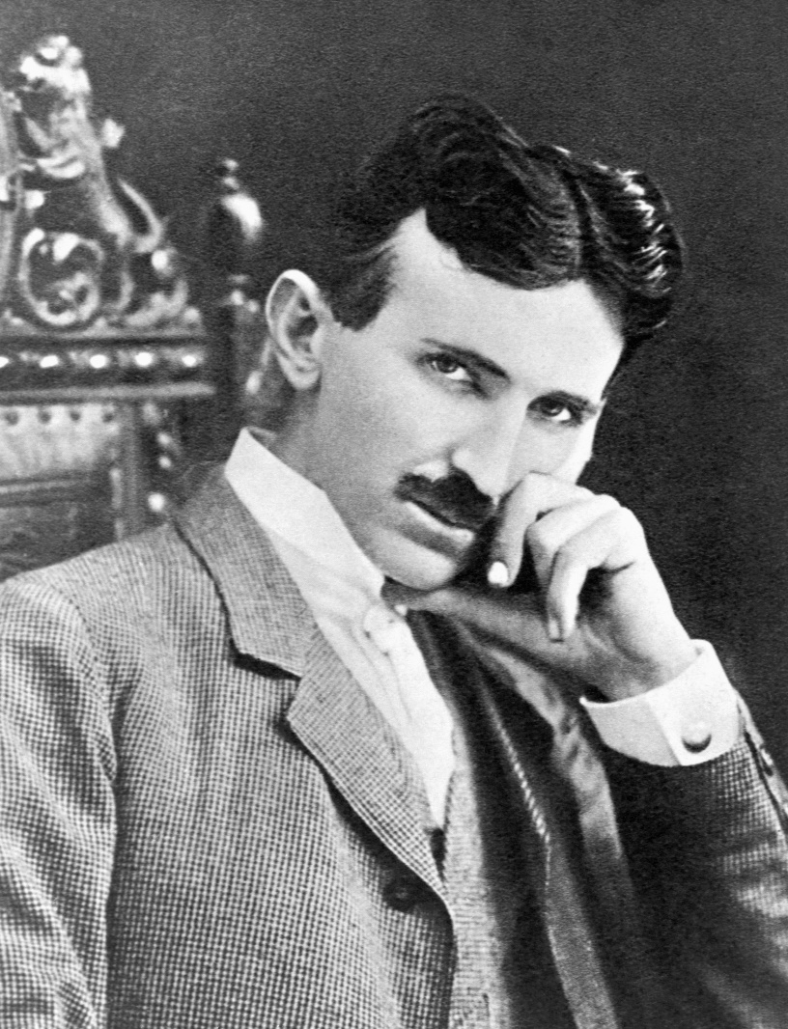
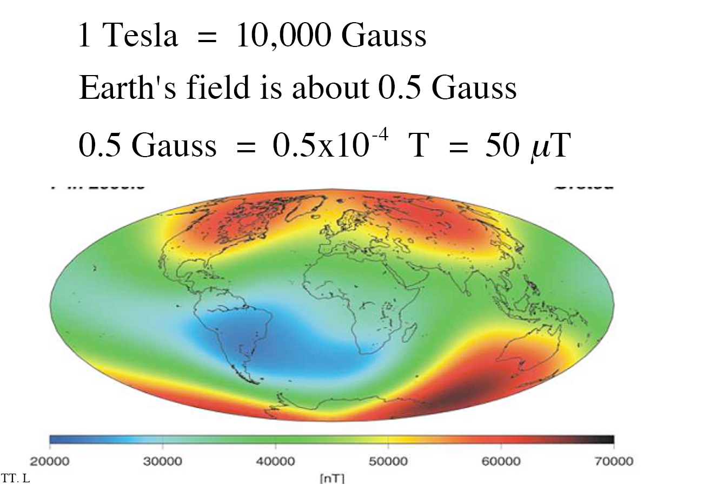
Magnetic Field
Nikola Tesla

Slide 14
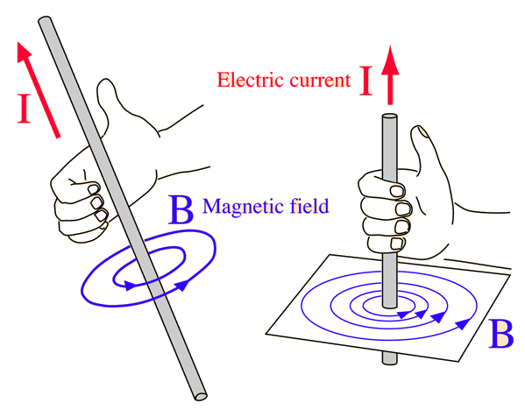
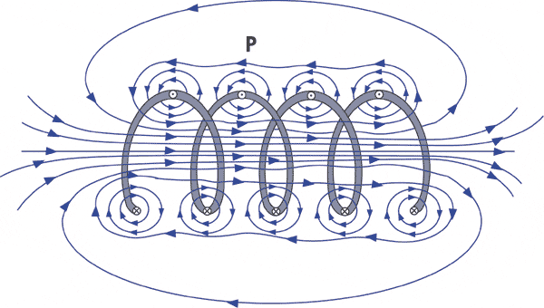
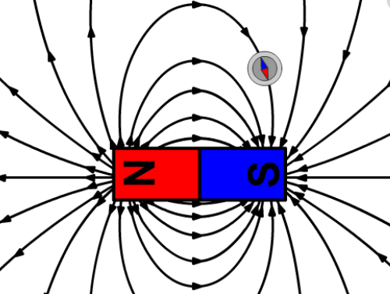
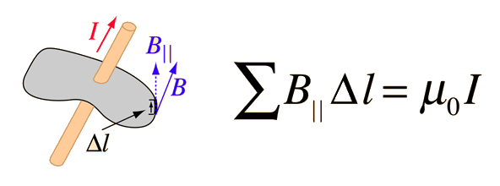
Electric Field to Magnetic Field (Ampere’s Law)

Slide 15
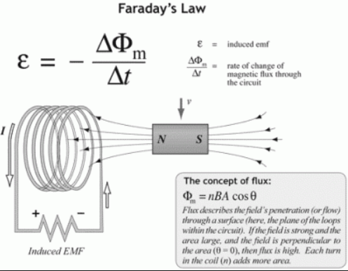
Magnetic Field to Electric Field (Faraday’s Law)

Slide 16
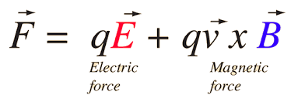
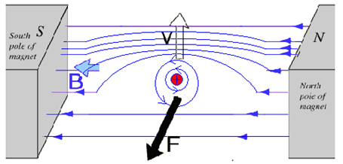
Lorentz Force

Slide 17
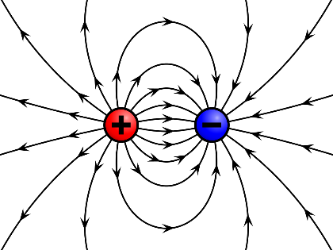

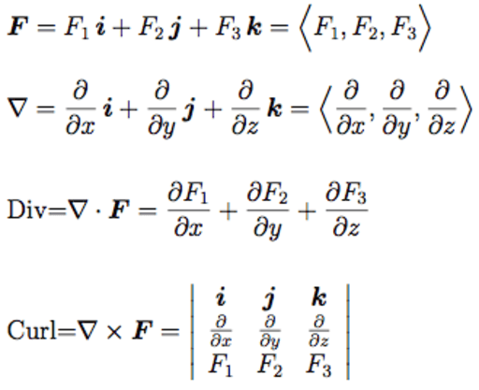

Physical Background: Divergence & Curl

Slide 18
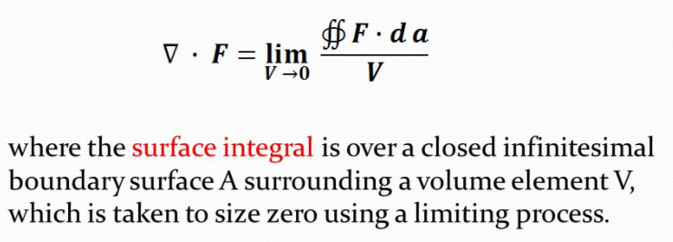
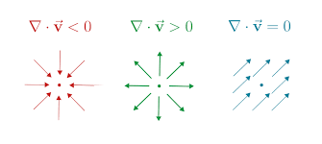
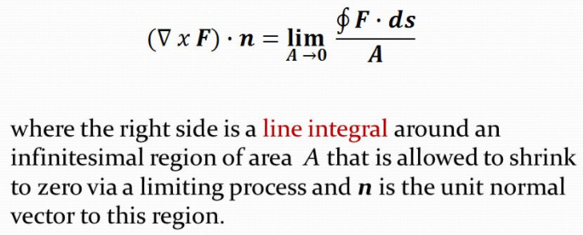
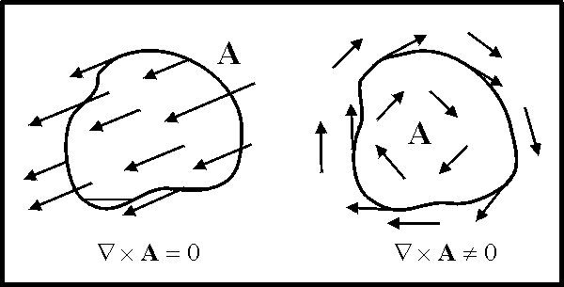
Formulation of Divergence & Curl

Slide 19
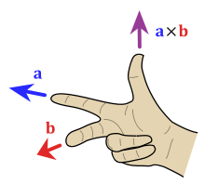
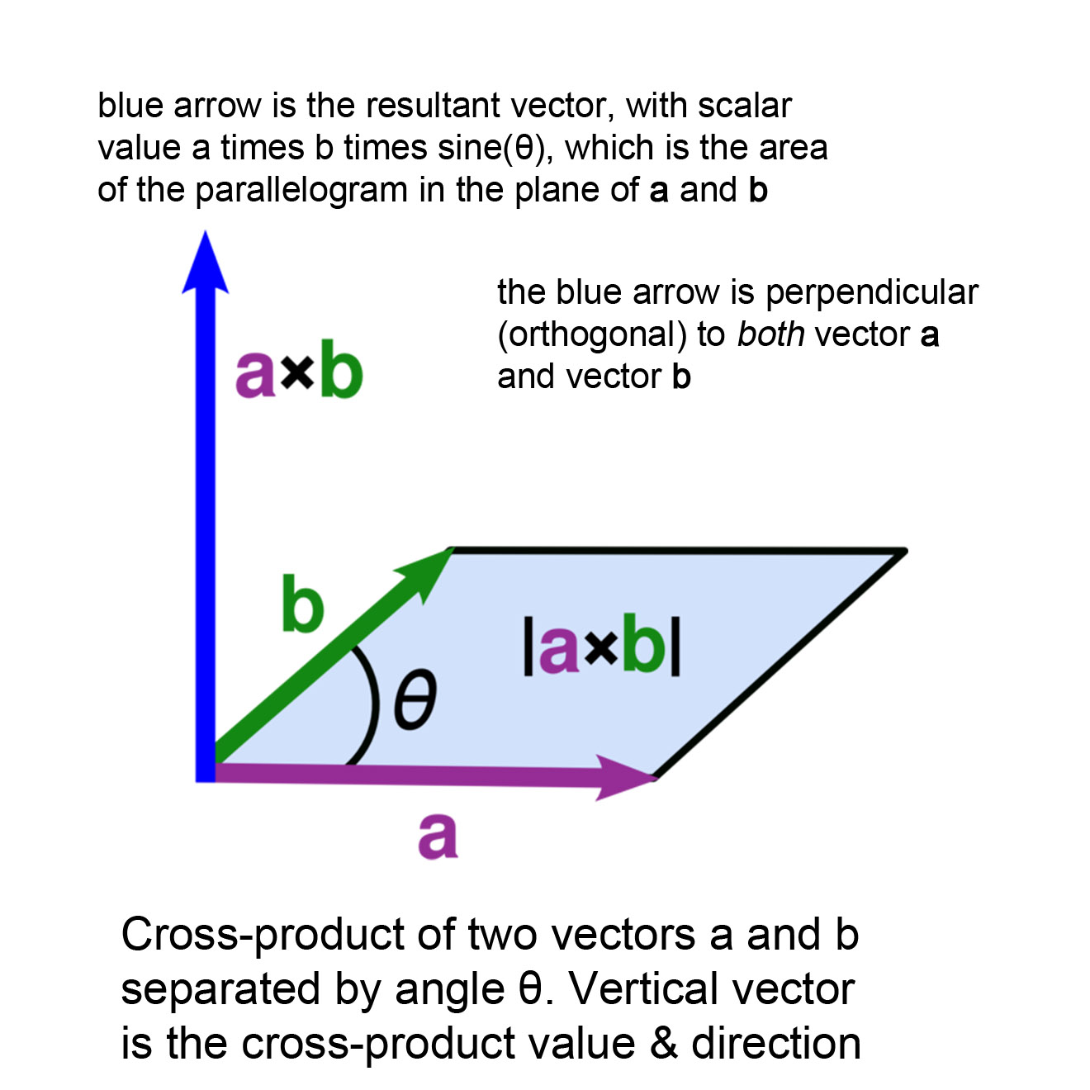
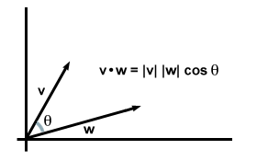
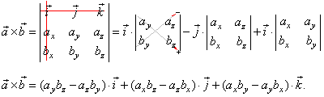
Math Operations: Dot & Cross Products

Slide 20
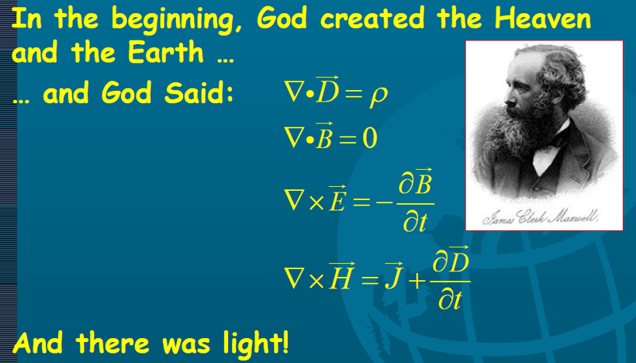

Slide 21
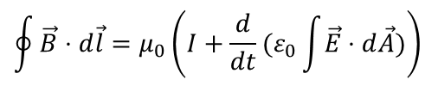
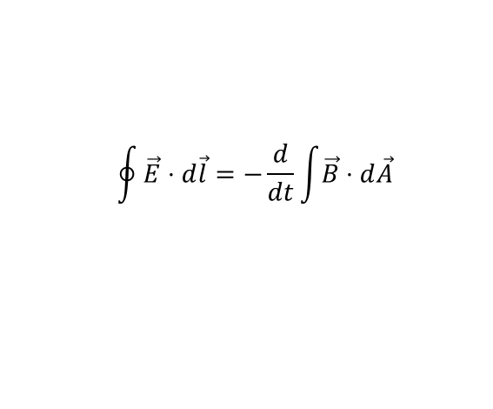
Maxwell's Equations
Gauss' Law for electricity
The total of the electric field over the surface of a volume equals the total charge inside
Gauss' Law for magnetism
No magnetic charge, i.e., no monopoles
Faraday's Law of magnetic induction
The left side is the total voltage change round a loop, and the right side is a varying magnetic field through the loop
Ampere's Law plus Maxwell's displacement current
The left side is the total magnetic force around a loop, and the right side is the current through the circuit, plus a varying electric field through the loop (displacement current)
$$\oint{\vec{E}⋅d\vec{l}=−\frac{d}{dt}}\int{\vec{B}⋅d\vec{A}}$$
$$\oint{\vec{B}⋅d\vec{l}=μ_{0}\left(I+\frac{d}{dt}(ε_{0}\int{\vec{E}⋅d\vec{A}})\right)}$$

Slide 22
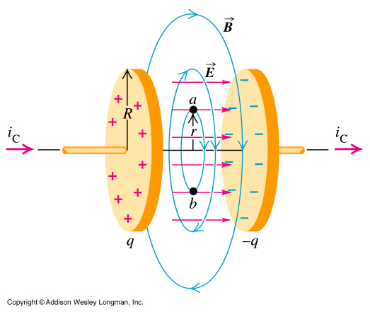
Displacement Current

Slide 23
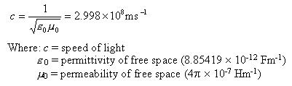

Speed of Light

Slide 24
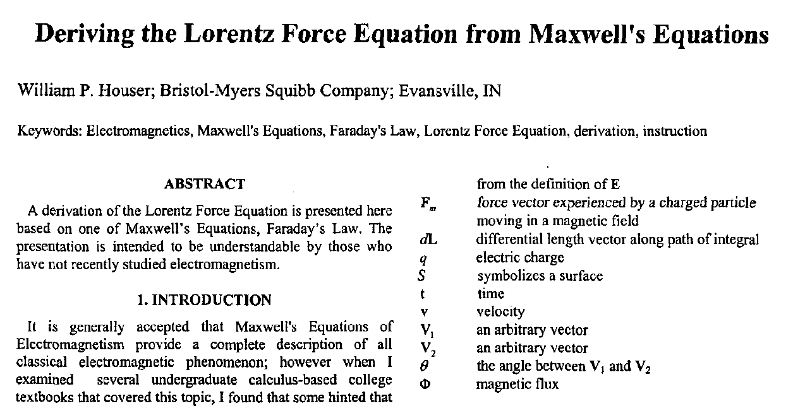
Lorentz Force Derived

Slide 25
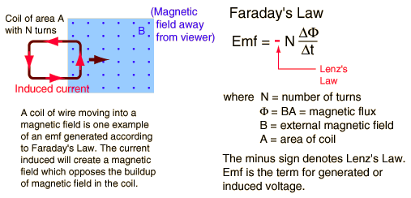
Ge’s Explanation
Faraday's Law
Symmetry & Differentiation (dA opposite of B)
Elimination
Vectorized
Actually, the above steps only compute the tangential component. Any E component along the motion direction? How about charges move along a circle?

Slide 26
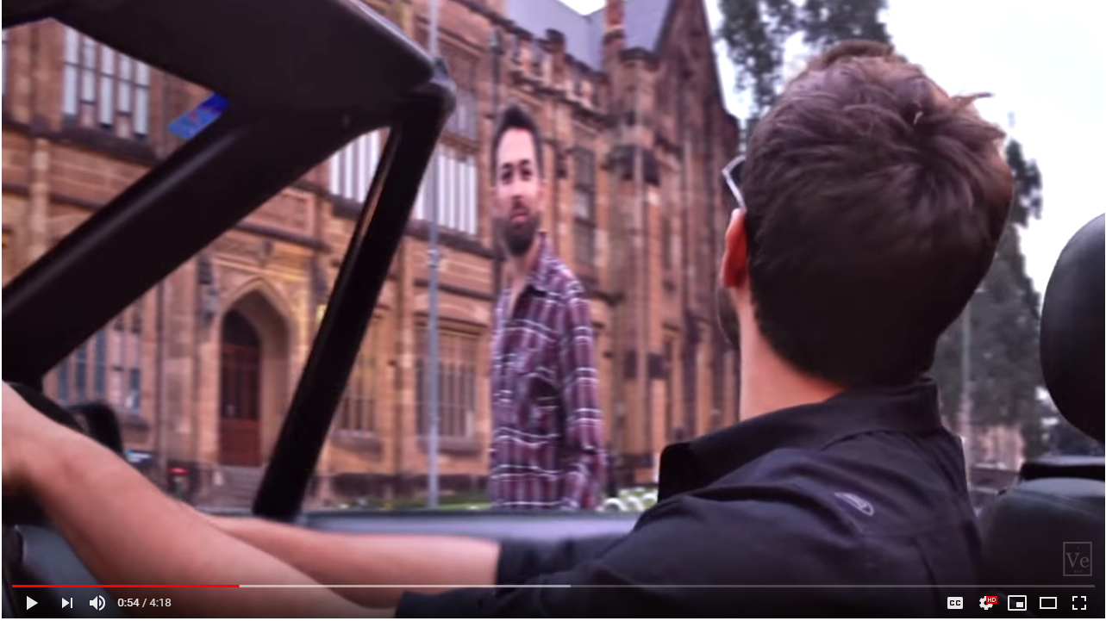
Magnetic = Electric
You are looking slim.
https://youtu.be/1TKSfAkWWN0

Slide 27
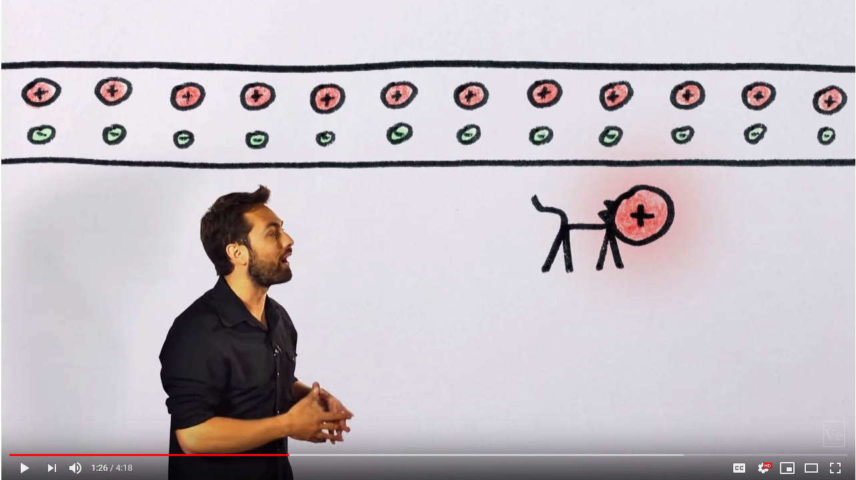
In the Lab Frame
Positive & negative charges are neutralized where negative charges & the cat move.

Slide 28
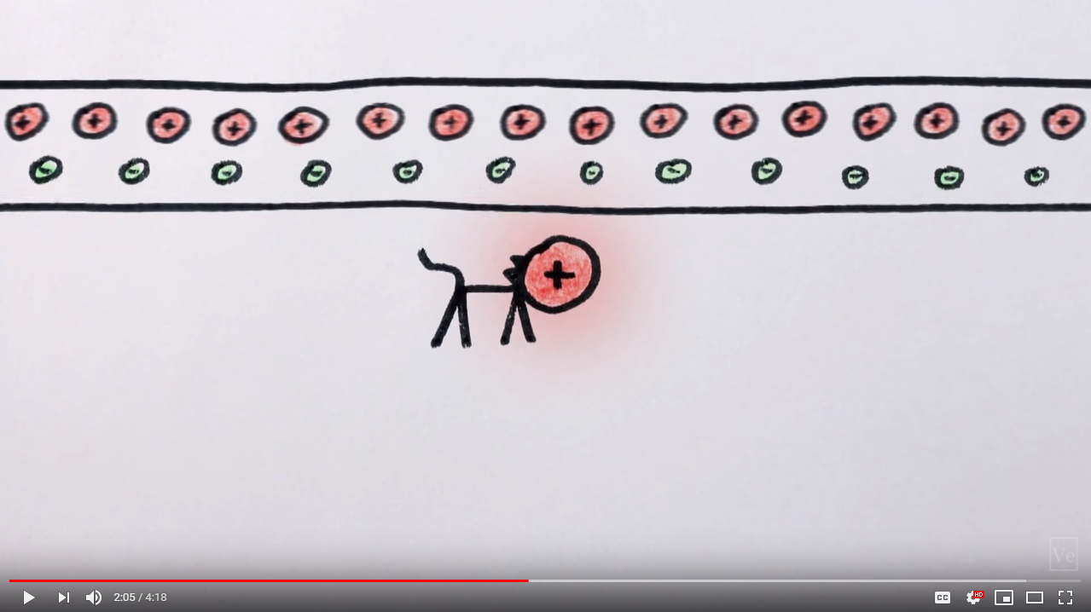
In the Cat Frame (Charges+)
Positive charges become denser than before, because they move in the cat frame.

Slide 29
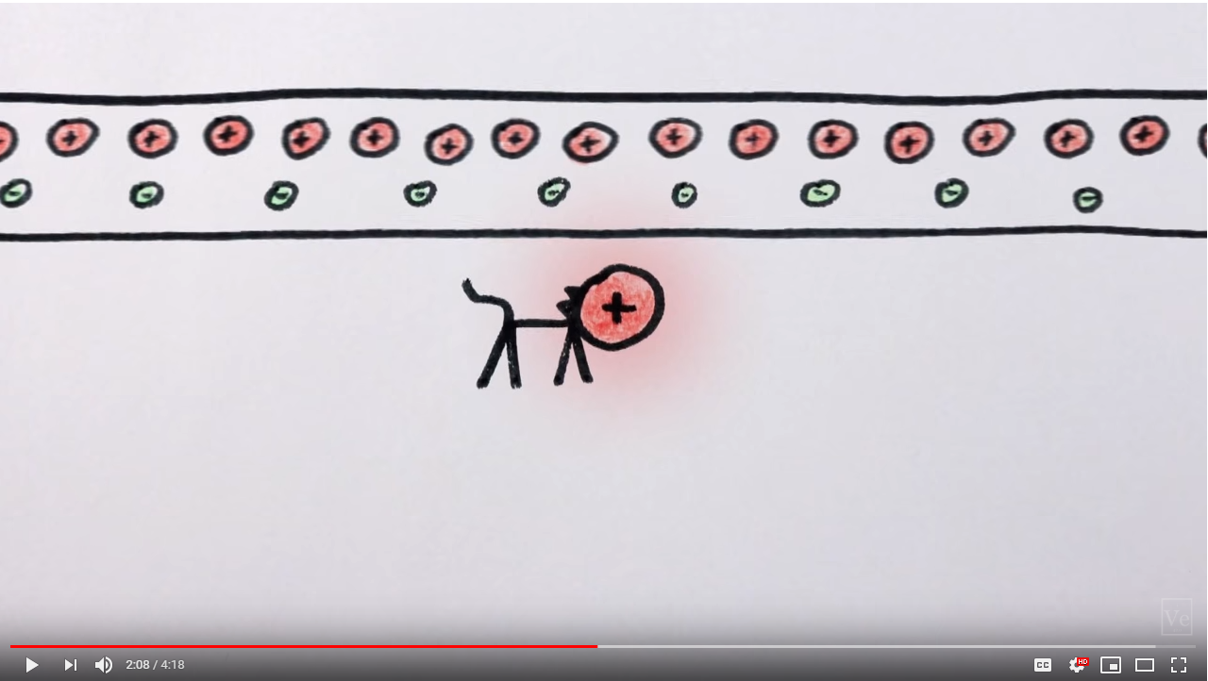
In the Cat Frame (Charges-)
Negative charges become sparser than before, because they move in the lab frame.

Slide 30
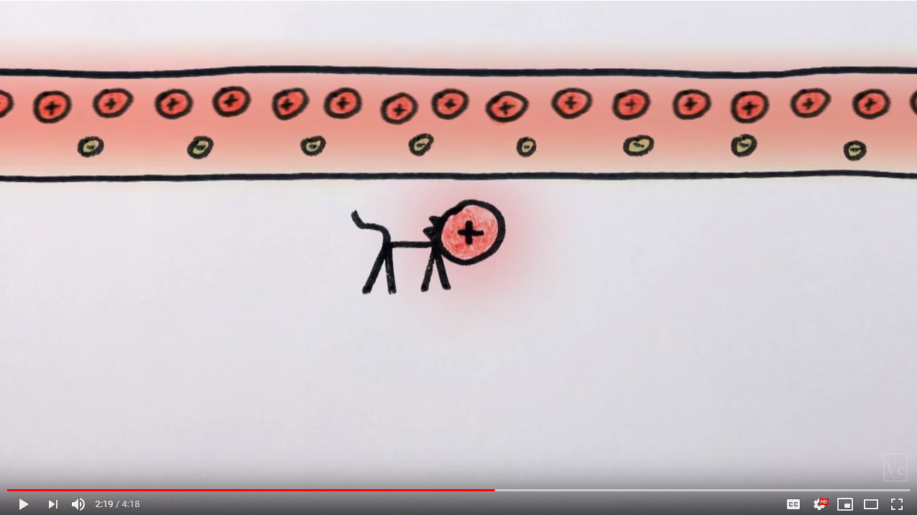
In the Cat’s Frame (Net Effect)
Hence, the wire tends to be electrically positive in two ways and repel the cat downward.

Slide 31
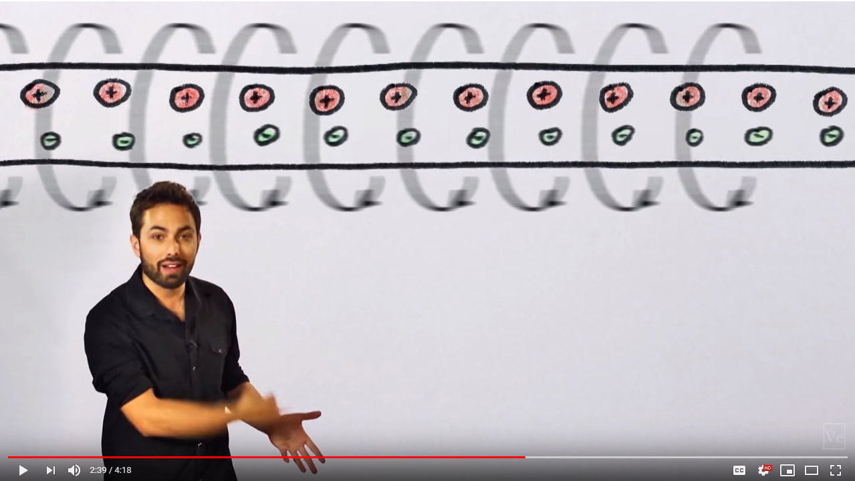
Alternative Theory in the Lab Frame
An alternative explanation is that the electrical current generates a magnetic field.

Slide 32
Outline
Physics
High School Electromagnetism
Maxwell’s Equations
Mechanics
Force to Torque
Precession

Slide 33
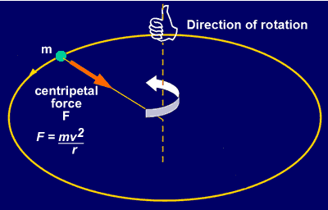
Centripetal Force Orthogonal to Motion

Slide 34
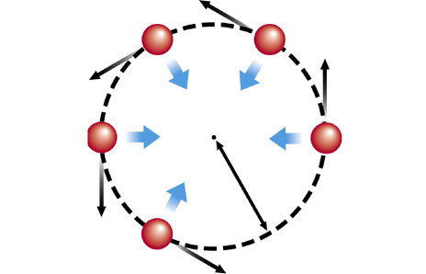
Circular Motion Demystified
Δs=vΔt
Δs’=0.5a(Δt)²
Radial displacement change is a higher order infinitesimal quantity (i.e., (Δt)² vs. Δt ).
Hence, the magnitude is still v, and only the angle changes (try to give details).

Slide 35
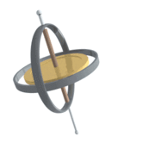

Precession
http://www.simplyphysics.com/MRIntro.html

Slide 36


Torque & Angular Momentum

Slide 37



Angular Momentum Changed by Torque

Slide 38

More Formally, Newton’s 2nd Law

Slide 39



Change of Angular Momentum
v
L
Δv
ΔL

Slide 40
Homework
Just read and try to understand
Maxwell’s equations and
precessional motion!
Additionally, read the latest review on the CT recon history, and write a 1-page summary of the paper

